Slide 1
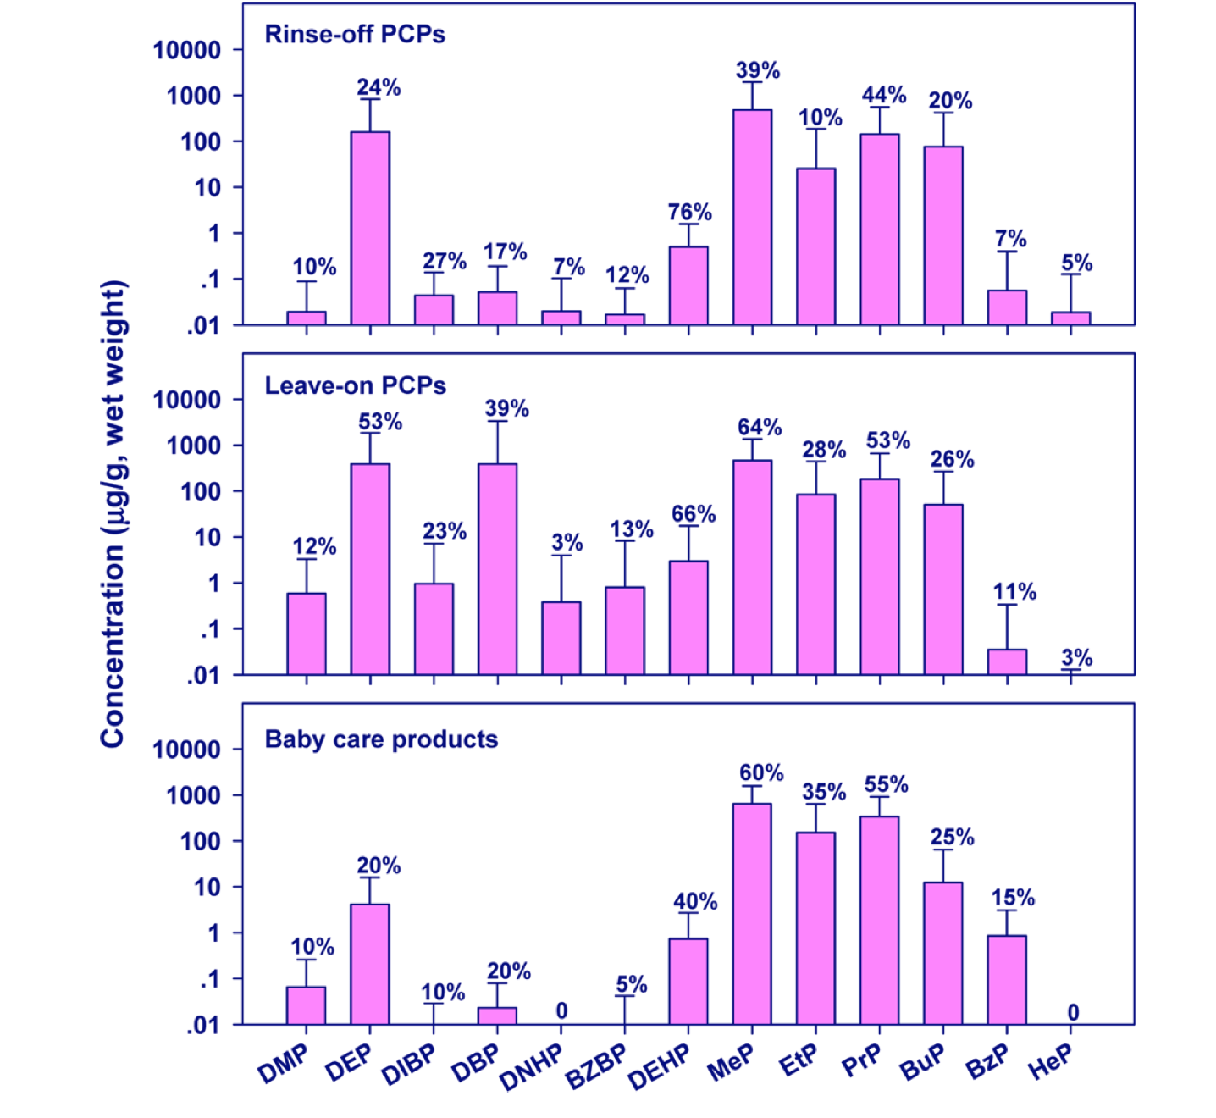
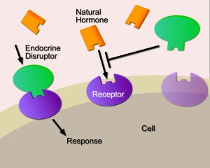
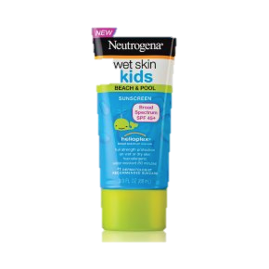
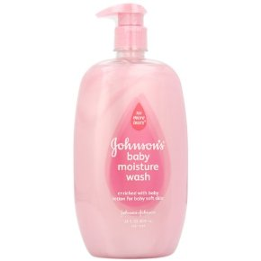
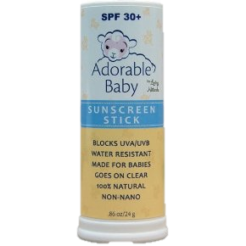
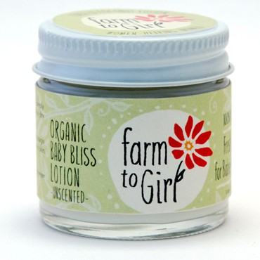
The Presence of Endocrine Disrupting Chemicals Found in Cosmetic and Personal Care Products for Children Marie Abrahams ‘14 and Molly Nash ’15 ES366: The Environment and Human Health Environmental Studies Program, Colby College
c
c
What are Endocrine Disrupters?
Endocrine Disrupters (EDs) are exogenous chemicals that can alter hormone signals throughout the endocrine system of an otherwise healthy organism.¹ They interfere with the “synthesis, secretion, transport, binding, action, or elimination of natural hormones in the body.”² Hormones released from the endocrine system are responsible for human reproduction, growth and development, sleep, metabolism, stress response, and the processing of vital nutrients, among other things.³ Infants and children are particularly susceptible to adverse affects of EDs because they lack the same capacity as adults to metabolize and eliminate many toxins.⁴
Parabens and Phthalates in Child Cosmetics
Current Policy
Under the Federal Food, Drug, and Cosmetic Act of 1938 (FFDCA), cosmetics do not need FDA approval before they are distributed.⁹
The safety and proper labeling of products is legally in the hands of the companies who market and distribute them.⁹
The Voluntary Cosmetic Registration Program is an FDA program that encourages, but does not require, companies to make their product information and safety data public.⁹
The FDA can conduct research on a product it there are reports of it being hazardous, but they cannot regulate it. They can only use their research findings to inform the public of safety hazards, to provide data to support legal regulation, or to share data with industry. ⁹
The Cosmetic Ingredient Review (CIR) is an expert panel of industry specialists that evaluates the safety of personal care products. This review is entirely funded by industry. ⁹
The EU’s Registration, Evaluation, Authorization, and Restriction of Chemicals (REACH) Regulation holds industry responsible for the safety of chemicals and assesses the risks of a chemical based on consumer safety rather than economic cost.¹⁰
REACH classifies phthalates on the Substances of Very High Concern list because of their carcinogenic and toxic reproductive effects.¹¹
Figure 1:
Receptors are meant to bind with natural hormones and create a response within the cell. Endocrine disruptors mimic natural hormones, bind to receptors, and cause adverse responses in the cell.
Figure 2. Concentration of phthalates and parabens in personal care products from a study conducted in New York state (Kannan, K., Guo, Y., 2013)⁶
Conclusions & Further Action
As illustrated by the health effects uncovered in our analysis, endocrine disruption is a pervasive and alarming public health hazard. Because endocrine disruptors are found in nearly all easily accessibly personal care products, the majority of Americans are exposed to them.
Further action should include educating the general public about the hazards present in the cosmetics they use and trust on a daily basis. Consumer awareness can also be used to lobby industry to change ingredients in their products and provide accurate safety data.
As most endocrine free products are more expensive than their common counterparts, alternative low cost yet safe technology should be developed to give all citizens access to healthy options.
Furthermore, the US government needs to prioritize the health of its people above the interest of industry. Europe has done so relatively successfully through REACH and the Cosmetics Directive 7Th Amendment which states, “A cosmetic product put on the market within the Community must not cause damage to human health when applied under normal or reasonably foreseeable conditions of use...”.¹²
http://epthinktank.eu/2013/03/11/eu-policy-on-endocrine-disruptors/
It is apparent from this study that although the concentration of certain endocrine disrupting chemicals is smaller in baby care products compared to regular personal care products (DEP, DIBP, DNHP, BZBP, DEHP, HeP), there are also several chemicals that have a chemical concentration that falls within the range of adult cosmetic concentration. Furthermore, some of the baby care products have an even higher level of EDs than their adult counterparts (EtP, PrP, BzP).
xc
Our research focuses on two major endocrine disruptors: parabens and phthalates . Although many more endocrine disruptors could be listed, we chose these based on their prevalence in personal care products (PCPs) and their pressing negative health effects.
Parabens: A family of preservative chemicals that are both estrogenic (mimic/block estrogen signals) and anti-androgenic (mimic/block testosterone signals )⁷. They are often used in cosmetics as fragrances. Parabens take the form of DEP, DBP, ethyl- (EtP), propyl- (Prp) and butyl (BuP) in personal care products.⁵ A study from 2013 found that dermal intake of parabens through PCP was greater for infants and toddlers than adult females.⁶
Health Effects:
Developmental/reproductive toxicity, ecotoxicity, genotoxicity
Carcinogenic
Mitochondrial dysfunction
Price Comparison
We performed a price comparison on children’s personal care products that contain parabens and/or phthalates versus their counterparts that are free from endocrine disrupting chemicals. We found that cosmetics containing our EDs were an average of $10.30 less expensive than the chemical free product.⁸ This begs the question: Who can afford to buy healthy products for their families?
Phthalates: A family of chemicals used to create flexible and durable materials that are anti-androgens. Phthalates are commonly found in perfumes, skin toners and nail polishes.⁶ A study found that dermal intake of phthalates through PCPs was lower for infants and toddlers then for adult females.⁶
Health Effects :
Reproductive birth defects in males/reproductive problems in females
Attention Deficit Disorder and learning disabilities
Insulin problems; obesity and diabetes
Increases risk of allergic diseases (asthma and eczema)
$8.39
$1.97
xc
Bibliography:
¹Dodson, Robin E., Marcia Nishioka, Laurel J. Standley, Laura J. Perovich, Julia Green Brody, and Ruthann A. Rudel. "Endocrine Disruptors and Asthma-Associated Chemicals in Consumer Products." Environmental Health Perspectives 120.7 (2012): 935-43. Web.
²Sun, Shudong, Jingyun Hunag, and Changsheng Zhao. "Polymeric Particles for the Removal of Endocrine Disruptors." Separation & Purification Reviews 40.4 (2011): 312-37. Web.
³ McAndrews, Joanne M., and Jacqueline Wu. "Introduction To The Endocrine System Part 2: Physiology." AMWA Journal: American Medical Writers Association Journal 28.2 (2013): 51-56. Academic Search Complete. Web. 23 Apr. 2014.
⁴Ünüvar, Tolga, and Atilla Büyükgebiz. "Fetal And Neonatal Endocrine Disruptors." Journal Of Clinical Research In Pediatric Endocrinology 4.2 (2012): 51-60. Academic Search Complete. Web. 23 Apr. 2014.
⁵ Gosens, I., Delmaar, C. J. E., Ter Burg, W., De Heer, C., & Schuur, A. G. (2014). Aggregate exposure approaches for parabens in personal care products: A case assessment for children between 0 and 3 years old. Journal of Exposure Science and Environmental Epidemiology, 24(2), 208-214.
⁶ Guo, Y., & Kannan, K. (2013). A survey of phthalates and parabens in personal care products from the united states and its implications for human exposure. Environmental Science and Technology, 47(24), 14442-14449.
⁷ Llompart, M., Celeiro, M., Pablo Lamas, J., Sanchez-Prado, L., Lores, M., & Garcia-Jares, C. (2013). Analysis of plasticizers and synthetic musks in cosmetic and personal care products by matrix solid-phase dispersion gas chromatography-mass spectrometry. Journal of Chromatography A, 1293, 10-19.
⁸ "Skin Deep® Cosmetics Database." Skin Deep Home Comments. Environmental Working Group, n.d. Web. 28 Apr. 2014.
⁹“U.S. Food and Drug Administration." Cosmetic Registration Program. N.p., n.d. Web. 23 Apr. 2014.
¹⁰"REACH - Registration, Evaluation, Authorisation and Restriction of Chemicals." Chemicals. European Commission, n.d. Web. 28 Apr. 2014.
¹¹Candidate List of Substances of Very High Concern for Authorisation. European Chemical Agency, n.d. Web. 28 Apr. 2014.
¹²"European Commission Cosmetics." Other Applicable EU Legislation. N.p., n.d. Web. 24 Apr. 2014.
$24.99
$8.95
Neutrogena sunscreen that contains phthalates for $8.39 versus its ED free counter part, Adorable Baby, for $24.99.
Johnson’s Baby Moisture Care Baby Wash that contains parabens for $1.97 versus the ED free counter part, Farm to Girl Organic Unscented Baby Lotion for $8.95.

